Slide 1

The True Apostolic Ministry
The Flip Side of Fruitful Ministry
Week 95
10 July 2024

Slide 2

2 Corinthians Introduction
In our continuing study of Second Corinthians, the themes of this letter revolves around both the theological concepts and the practical aspects of Christian living.
The primary issue at Corinth was the recognition of authentic ministry and submission to apostolic authority. Paul’s corrective was to provide guidance and encouragement as the church navigates the challenges that continue to influence their unity, discipline, and spiritual growth.
In our study, Paul addresses the problem of false apostles undermining his authority and leading the Corinthians astray through boasting and exploitation. He defends his ministry by contrasting his genuine sufferings and dedication with their self-serving behavior, reaffirms his apostolic authority, and teaches the Corinthians about true Christian leadership.

Slide 3

The Flip Side of Fruitful Ministry 11:16 - 33

Slide 4
2 Corinthians - Lesson Overview
Swindoll . . . opens by reminding us that ministry, like all of life, has it’s “flip” side.
I arrived at an airport on the East Coast for a speaking engagement and the president of a Christian college met me.
When I saw him, I could tell something wasn’t quite right. He looked like the weight of the world had been stuffed into an invisible backpack and placed on his shoulders.
He was stooped over and looked a little grim. I called his name, gave him a big hug and said, “Well, how are you doing?”
He responded, “How am I doing? I’m growing and I am learning.”
You know, Chuck, several years ago I used to have a glib answer when people asked me, ‘How are you doing?’

Slide 5
2 Corinthians - Lesson Overview
I always responded loudly, “Fantastic!” But these last few years I have decided to get real – to be honest.
The best I can say today is ‘I’m growing and I’m Learning, but I’m not fantastic!’
Swindoll says . . . many of us need to learn what the college President was honest enough to admit.
To always answer “Fantastic!” is to hide the reality of our pain and leave a false impression that our lives are a colorful bed of roses.
Yes! On occasion we do enjoy the touch of God’s favor – times when we can honestly smile and utter “Fantastic!”
But more often than not, the answer really ought to be, “I’m growing and I’m learning.”

Slide 6
2 Corinthians - Lesson Overview
Life that is lived realistically is not lived fantastically.
Even the “best” Christians are not immune to abrasive and harsh rubs with reality. The painful shoves of disaster, disease, and death jostle the Christian as often as anyone else in this world.
These things can make shambles of our lives, tear apart our families, and leaves us reeling for days, weeks, or even years.
Real life is often the flip side of “fantastic.”
Like the rest of life, ministry can have its occasional fantastic moments, but more often than not, we need to be prepared for the flip side when we are simply growing and learning.

Slide 7
2 Corinthians - Lesson Overview
Sometimes through pain. Other times through hardship. Always through patience and perseverance found through prayer and faith. That’s real ministry.
In the first century church at Corinth, the absence of a strong apostolic witness like Paul, Peter, or the teacher Apollos created a vacuum of sound leadership that was quickly filled by false teachers.
They came, looking better than Paul, preaching better than Paul, and touting impressive credentials Paul did not appear to have.
As a result, Paul was forced into an uncomfortable situation of having to boast about his own qualifications and accomplishment and assert his own credentials as an apostle.

Slide 8
2 Corinthians - Lesson Overview
Some of the characteristics of Paul’s authentic apostleship make up the flip side of fruitful ministry.
Such as, the realistic picture of suffering, persecution, pain, and pressure that went along with his genuine concern for the churches.
So, while the false teachers put on a bright face of “fantastic,” Paul described the real ingredients of growing and learning in ministry through the daily trials of life.

Slide 9
2 Corinthians 11:16–21
¹⁶ I say again, let no one think me a fool. If otherwise, at least receive me as a fool, that I also may boast a little. ¹⁷What I speak, I speak not according to the Lord, but as it were, foolishly, in this confidence of boasting. ¹⁸Seeing that many boast according to the flesh, I also will boast. ¹⁹For you put up with fools gladly, since you yourselves are wise! ²⁰For you put up with it if one brings you into bondage, if one devours you, if one takes from you, if one exalts himself, if one strikes you on the face. ²¹To our
shame I say that we were too weak for that! But in whatever anyone is bold—I speak foolishly—I am bold also.

Slide 10
2 Corinthians 11:16-21
Paul could barely tolerate the uncomfortable position in which the false teachers had put him. He had no qualms about writing page after page about Jesus Christ, His saving work, and our faith response to the Gospel.
Paul could pen long treatises on grace, practical instructions for the Christian life, and manuals for pastoral ministry.
But when it came to his own accomplishments, Paul would rather hide under a rock than brag about himself.
So here in 11:16-19, Paul apologizes for his need to go on boasting. He says, “What I am saying, I am not saying as the Lord would, but as in foolishness, in this confidence of boasting” (11:17).

Slide 11
2 Corinthians 11:16-21
In other words, the boasting that Paul did was not Christ-like. Jesus would not have done it.
The Corinthians had become so enamored with the false teachers who foolishly boasted about their credentials, that Paul had determined to fight folly with folly.
So, he reluctantly put himself in the role of the foolish boaster, meeting the braggarts on their own turf and defeating them at their own game.
Paul’s disappointment was evident as he points out the abuse the Corinthians willingly endured at the hands of the false teachers (11:20).

Slide 12
2 Corinthians 11:16-21
They enslaved the church to the yoke of legalistic bondage.
They devoured them with their false doctrines.
They took unfair advantage of their hospitality and financial generosity.
They exalted themselves above the truly qualified leaders in the church.
They metaphorically struck the Corinthians in the face.
And the worst part! Not a single one of them had any authority or right to do any of that.
So, this is why Paul is willing to take such desperate rhetorical measure as to boast about his accomplishment in the proud manner of his opponents.

Slide 13
2 Corinthians 11:16-21
Compared with the false teachers Paul describes himself as weak (11:21). He had neither their worldly charisma nor cultural sophistication.
Paul never made it a point to display fancy rhetorical footwork or to emphasize his curriculum vitae. He didn’t hang his diplomas on his front door or drop names of the famous people he knew or studied under.
So, on the surface Paul and his associates appeared “weak.” But with a sudden cataloguing of his credentials and accomplishments, the tide turns.

Slide 14
2 Corinthians 11:22-33
²²Are they Hebrews? So am I. Are they Israelites? So am I. Are they the seed of Abraham? So am I. ²³Are they ministers of Christ?—I speak as a fool—I am more: in labors more abundant, in stripes above measure, in prisons more frequently, in deaths often. ²⁴From the Jews five times I received forty stripes minus one. ²⁵Three times I was beaten with rods; once I was stoned; three times I was shipwrecked; a night and a day I have been in the deep; ²⁶in journeys often, in perils of waters, in perils of robbers, in perils of my own countrymen, in perils of the Gentiles, in perils in the city, in perils in the wilderness, in perils in the sea, in perils among false brethren; ²⁷in weariness and toil, in sleeplessness often, in hunger and thirst, in fasting often, in cold and nakedness— ²⁸besides the other things, what comes upon me daily: my deep concern for all the churches. [continue . . .]

Slide 15
2 Corinthians 11:22-33
²⁹Who is weak, and I am not weak? Who is made to stumble, and I do not burn with indignation? ³⁰If I must boast, I will boast in the things which concern my infirmity. ³¹The God and Father of our Lord Jesus Christ, who is blessed forever, knows that I am not lying. ³²In Damascus the governor, under Aretas the king, was guarding the city of the Damascenes with a garrison, desiring to arrest me; ³³but I was let down in a basket through a window in the wall, and escaped from his hands.

Slide 16
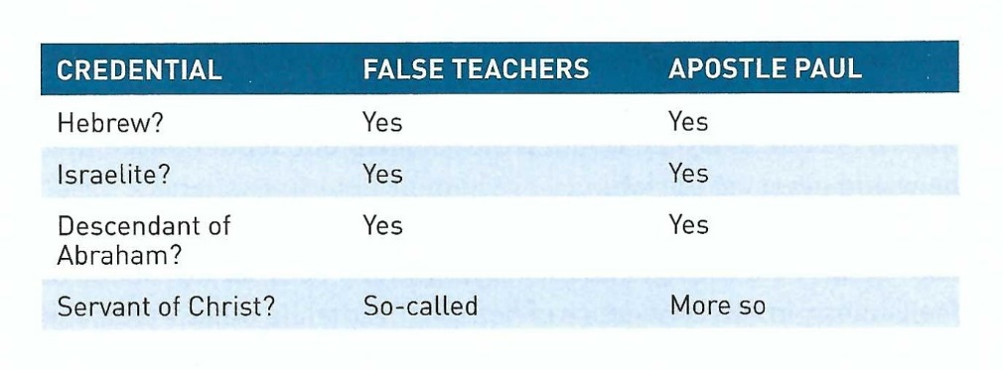
2 Corinthians 11:22-33
The false teachers had their set of impressive credentials. Once Paul opened the door to a little boasting about things that didn’t really matter to ministry (11:22), he matched and far exceeded them.
Paul lingers in the last credential (11:23) because this is the heart of the matter.
The Judaizing false teach had a Hebrew pedigree, but did they have a heart of sincere devotion and sacrificial service to Christ?

Slide 17
2 Corinthians 11:22-33
The Corinthians had become enslaved to these masters of rhetoric and oration. They had become impressed with the external sparkle of their slick, polished presentations.
But, had the Corinthians considered this last credential, were these bona fide Hebrews also authentic servants of Christ?
Just to put ministry in it’s truest perspective, instead of listing his accomplishments, Paul highlights his setbacks (11:23-27).
Scar by scar, he shows the Corinthians his battle wounds. Each tells a story of genuine devotion to Christ in contrast to the false teachers’ life of comfort and ease.
The Judaizers lived in a world where they used the word “fantastic” to describe their ministries. And why not?

Slide 18
2 Corinthians 11:22-33
They showed up in churches already established by Paul’s toil, tears, and tribulations.
Like thieves harvesting where they hadn’t sown, the false teachers performed ministries of ease. On the other hand, Paul’s world of ministry was one of growing and learning, filled with pain, heartache, and uncertainty.
Paul’s uphill, winding road followed Christ to the cross – a life of suffering and sorrow (Heb. 12:2-3; 1 Pet. 2:21).
If all the crushing circumstances Paul rattled off in these verses weren’t enough to convince the Corinthians of his authentic ministry, he also describes the pains of anxiety.
In 11:28 he says, “Apart from such external things, there is the daily pressure on me of concern for all the churches.”

Slide 19
2 Corinthians 11:22-33
Cumulatively, these pressures had molded Paul into the man he had become. They made him weak and defenseless, but also empathetic.
Therefore, he could strengthen the weak and show his genuine concern for those tempted to sin (11:29).
When you have suffered like Paul – with both external and internal catastrophes, crises, and concerns – your faith moves for the theoretical realm into the practical.
This allows for authentic spiritual learning and growing and genuine ministry as a true servant of Christ.
“Fantastic” days are the exception to the rule, as believers we live in the realm of the real rather than the imaginary.

Slide 20
2 Corinthians 11:22-33
When you’ve been weakened by the trials of ministry, you understand a person in weakness. When you’ve been there yourself, you are concerned, not condemning.
Think about it! When you finally get rid of the fake “Fantastic!” response to “How are you doing?” you become vulnerable and accessible.
Nobody weakened by calamities feels comfortable seeking comfort and understanding from so-called “successful” people who seems to always have it all together.
Nobody struggling with sin wants to get counsel from a believer who never seems to battle temptation.
Paul emphasizes his weaknesses, not his strengths, as proof of his authentic servanthood (11:30).

Slide 21
2 Corinthians 11:22-33
Having been forced to boast in defense of his ministry, Paul chooses to boast regarding his weaknesses.
At the climax of this boasting, Paul tells the story of narrowly escaping the city of Damascus in a basket through a window in the city wall (11:31-33).
Imagine, on that day, if Paul had responded “fantastic” when ask “How are you doing?”
That would have been good: if ‘fantastic’ means “you were dumped into a rickety basket like a sack of salt and lowered out of window like somebody’s trash.”
Conversely, if he said, “Honestly, I had a really bad day. In fact, I thought I was going to die in Damascus!”
“But I am learning and growing from all of this.”

Slide 22
2 Corinthians 11:22-33
We can’t be sure how the person inquiring would have responded to Paul’s transparency.
Chances are that Paul’s openness and transparency would have granted an opportunity for sharing in another’s hardship and heartaches.

Slide 23
Applications
Of the
lesson
Boasting Like Paul

Slide 24
Application – Boasting Like Paul
In closing Swindoll says . . . I’m convinced that Paul’s credentials for ministry would have driven a pastoral search committed or missionary-sending agency absolutely batty.
His was not at all like the pristine and impressive resumes flaunted by his professional opponents in Corinth.
Paul’s lengthy curriculum vitae in 11:22-33 was written in blood, stained with tears, smeared with dirt, and tattered by enduring too much action in a raging spiritual war that left him stooped over, not standing erect.
Three things stand out about Paul’s description of his credentials, his circumstance, and his character.

Slide 25
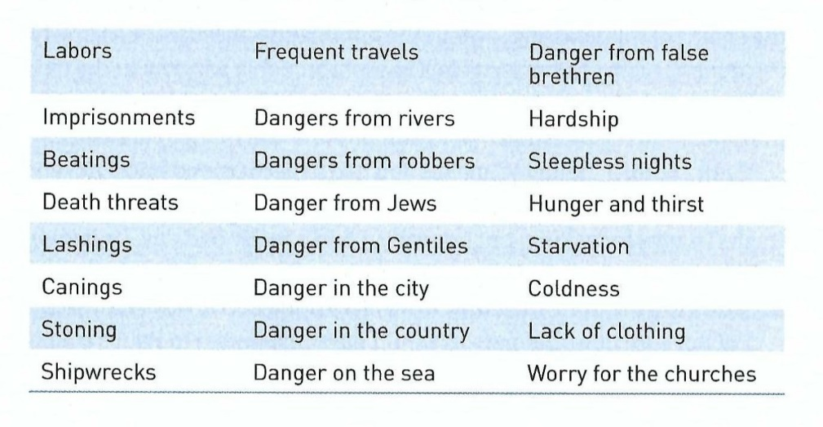
Application – Boasting Like Paul
First – Paul doesn’t deny the pain and pressures of life. He doesn’t pretend that everything’s “fantastic” when his world is crumbling around him.
Never once does he suggest that following Christ is a problem-free stroll through the park. Look at the many hardships Paul endured in ministry:
Now compare them to the trials you have experienced in church life, or any ministry in which you’ve been involved.

Slide 26
Application – Boasting Like Paul
As we consider our own ministry context, chances are neither you nor anyone you know has experienced even half of these things in ministry.
Second – Paul doesn’t market the misery of his ministry. Paul shared his litany of hardships only because he had to.
You get the distinct impression that he found it awkward to talk about himself in those terms. He would much rather talk about the sufferings and triumph of Christ than about his own trials and buffetings.
In telling his story, he didn’t seek pity or consolation. He didn’t share war stories for public applause. He didn’t increase his fame as “the apostle who spent a day and a night adrift at sea” or “the minister who endured beating, canings, and stoning.”

Slide 27
Application – Boasting Like Paul
Paul could have easily marketed his experiences into an opportunity to increase his own renown as a bona fide hero.
We need to be careful about talking too much about ourselves.
There is a fine line between legitimately sharing a testimony of how God has worked in our lives in spite of hardship and becoming either a complainer or a braggart for our own gain.
Our stories of agony and ecstasy can help comfort and encourage others. But we must always ask ourselves: Am I actually doing this because I want everybody to know what I’ve suffered in this of faith? Are my reasons for telling this pure or tainted? What’s my motive?

Slide 28
Application – Boasting Like Paul
Third – Paul doesn’t even try to explain why these things happened.
So many people claim to be “fantastic!” because they believe that to confess anything negative would reflect poorly on our Savior.
But God never promised smooth sailing. On the contrary, He promised a bumpy ride (John16:33) . . .
“These things I have spoken to you, that in Me you may have peace. In the world you will have tribulation; but be of good cheer, I have overcome the world” [NKJV].
In his account of suffering for the sake of the gospel, Paul makes no attempt at analyzing or moralizing. Although, he could confess with all of us that he grew and learned from these experiences.

Slide 29
Application – Boasting Like Paul
He didn’t attempt to defend God by explaining exactly how he grew and what new things he learned.
Most of the time, we can’t put such lessons into words.
We, too, should learn to endure the suffering without obsessing over the “why” questions.
They may never come on this side of glory. And then, we won’t need an answer.

Slide 30


The Flip Side Of Fruitful Ministry

Slide 31
NEXT CLASS – 17 July 2024
Book of Second Corinthians
Before next class, read the below chapters in the KJV and in one other versions of the Bible, i.e., NIV, NRSV, TLB, CEV, etc …
Chapter 12:1 – 10
“Gloves of Grace for Handling Thorns”

